Slide 1
BIOMETRICS
Subject code :18UITE52
Class : iii it
Semester : v

Slide 4
https://www.tutorialspoint.com/biometrics/index.htm
https://www.javatpoint.com/biometrics-tutorial

Slide 5
UNIT 1

Slide 6
BIOMETRICS
Bio (Greek word for Life)
Metrics (Measurements)
Branch of Information Technology
Establishes one’s identity based on personal traits

Slide 7
Applications of Biometrics
Commercial--computer network login e-commerce
Government--driver’s license
border control
passports
nation ID cards
Forensic -- terrorist identification identifying missing children criminal investigation

Slide 8
Biometric Surveillance System
CCTV based surveillance
Facial recognition
Recognizes individual from a distance
high resolution surveillance cameras
Extracts facial features from imperfectly captured images
Gait recognition
Manner of walking

Slide 9
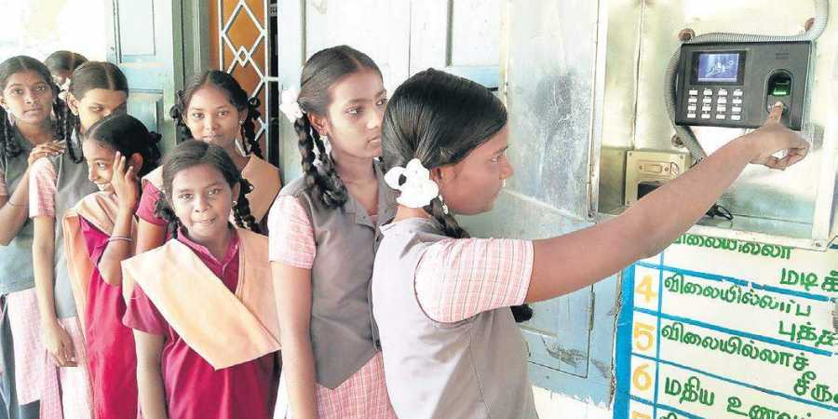
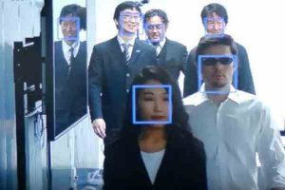
Airport Security
Biometrics Attendance

Slide 10
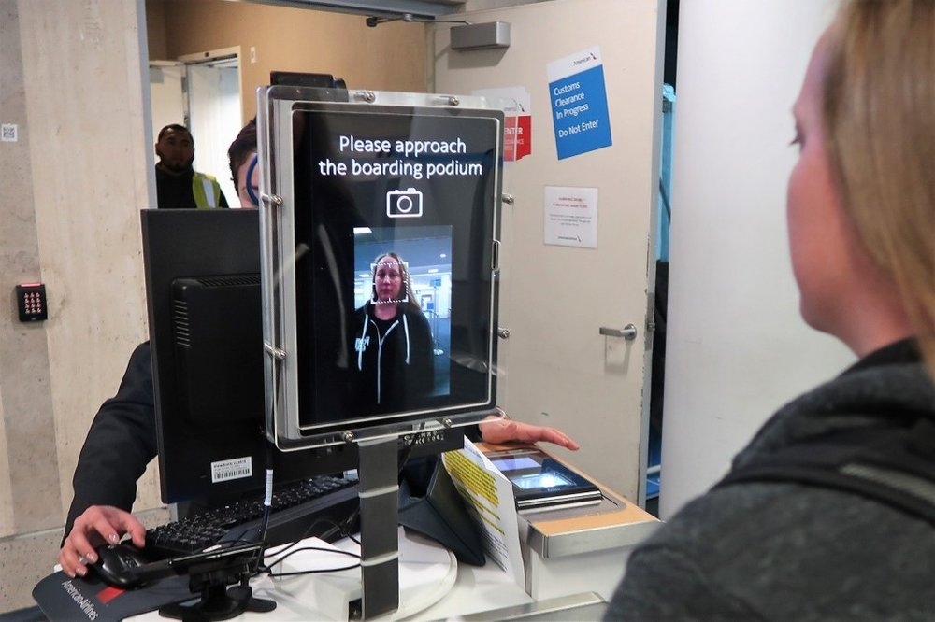
Hotel Checkin using Biometrics

Slide 11
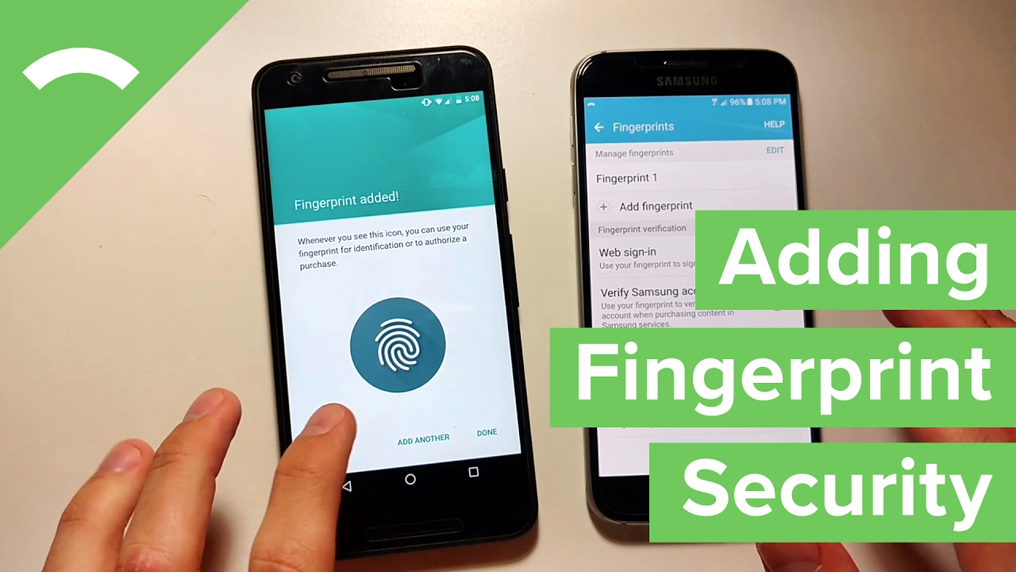

Slide 12
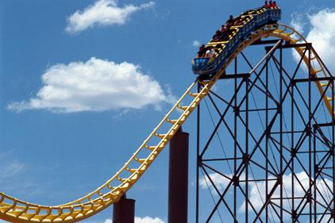
theme park visitor management using biometrics

Slide 13
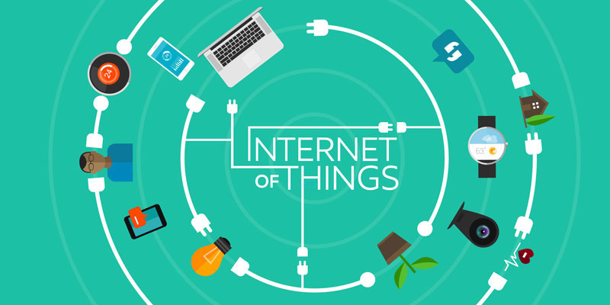
Biometrics: the future of the IoT security
Smart car- low fuel alert to your smartphone so that you can plan beforehand to carry extra time for fuel filling.
smart refrigerator,-sensing the environment inside the refrigerator, different food items in different compartment, optimum temperature for different sections, or sensing items for replenished

Slide 14
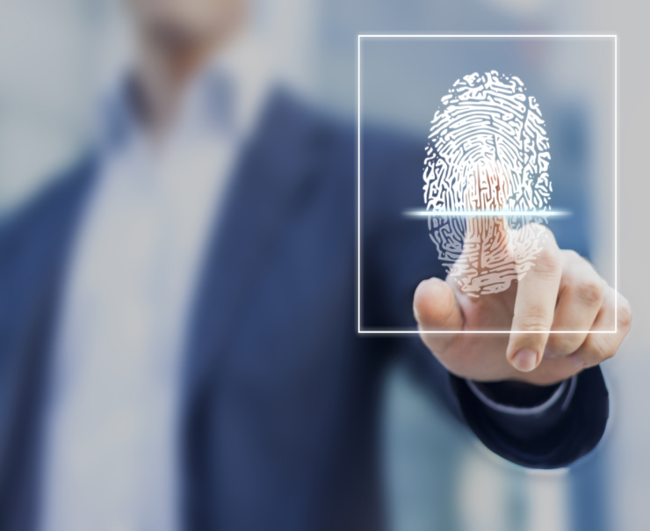
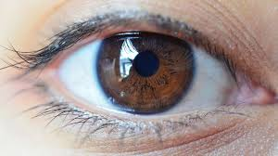
Physical Characteristics

Slide 15
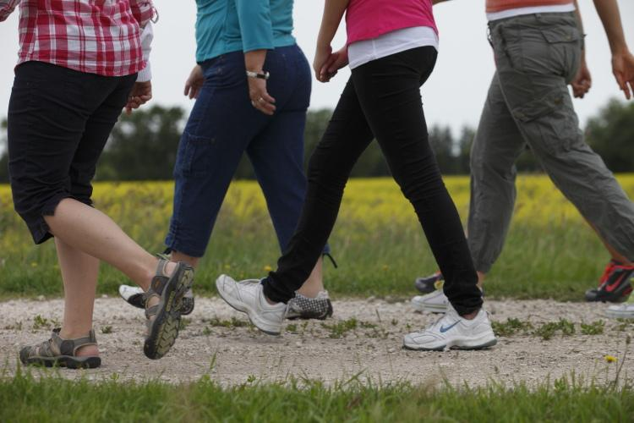
Behavioral Characteristics

Slide 16
Salary Range
$25,000 to $100,000+
Minimum Education Level
Bachelor's Degree
Personality Traits
Problem-Solving
Scientific
Technical
Career Ladder
Project Manager
Biometric Systems Engineer
Biometric Systems Technician

Slide 17
What is MFA?
Multi Factor Authentication
MFA creates multiple layers of security to help increase the confidence that the user requesting access is actually who they claim to be

Slide 18
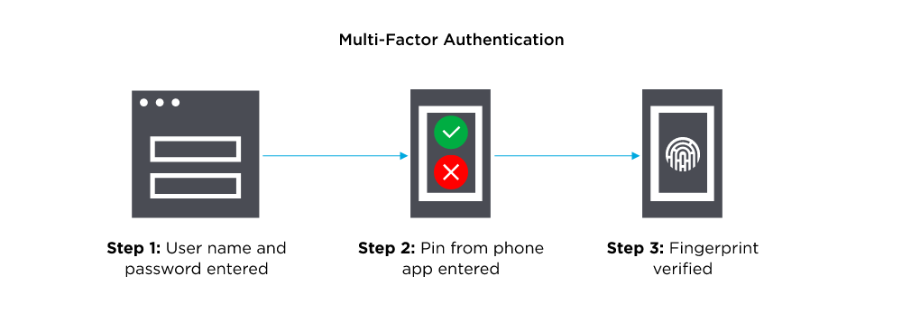

Slide 19
How does Multi-Factor Authentication work?
Security system that verifies a user’s identity by requiring multiple credentials
Critical component of Identity and Access Management (IAM)
Rather than just asking for a username and password
MFA requires other—additional—credentials
a code from the user’s smartphone
the answer to a security question
a fingerprint
facial recognition
Effective way to provide enhanced security

Slide 20
Traditional usernames and passwords
Can be stolen
Increasingly more vulnerable to brute force attacks

Slide 21
Examples of elements used in Multi-Factor Authentication
Codes generated by smartphone apps
Soft tokens, certificates
Fingerprints
Codes sent to an email address
Facial recognition
Retina or iris scanning
Behavioral analysis
Answers to personal security questions

Slide 22
How Authentication works?
During authentication, credentials provided by the user are compared to those on file in a database of authorized users’ information either on the local operating system or through an authentication server. If the credentials match, and the authenticated entity is authorized to use the resource, the process is completed and the user is granted access.
Types of authentication factors
Something you know (knowledge), such as a password or PIN
Something you have (possession), such as a Tokens or Smartphone
Something you are (inheritance), indicated through biometrics, like fingerprints or voice recognition
Single/Multi-Factor Authentication
Single-factor authentication (SFA) is the process of using a single method to authenticate. (For example a username and password or a smart card) but Multi-factor authentication (MFA) needs two or more methods of the authentication process. (For example, the first method is a USB token from a security application and then entering the username and password)

Slide 23
In MFA should use methods from at least two of the five different factors:
What you know (For example a password)
What you have (For example a smart card or USB token)
What you are (Such as biometrics authentication methods)
Somewhere you are (For example location or IP address)
Something you do

Slide 24
What Do You Know
The something you know factor is the most common factor used and can be a password or a simple personal identification number (PIN).
Passwords
When using passwords, it’s important to use strong passwords. A strong password has a mixture of upper case, lower case, numbers, and special characters.
Today, security professionals recommend that passwords should be at least 15 characters long.
Passwords should not include personal data like a user’s name or username. Additionally a password should not be a word that can be found in a dictionary. A dictionary attack uses a database of words similar to a dictionary, trying all the words in the database for a match.
Also, you should set maximum password aging to require password changes at regular intervals: 30-, 60-, or 90-day periods are common.
Password re-use settings allow a system to remember previously used passwords for a specific account. This security setting prevents users from circumventing maximum password expiration by alternating between two or three familiar passwords when they’re required to change their passwords.
Each of us in today’s world have passwords on websites, email services and various applications. This means that each of us must remember a large number of passwords. Security experts recommend using password managers to solve this problem.

Slide 25
PIN:A personal identification number (PIN) is a numerical code. The core purpose of a PIN is to provide an additional layer of security to the electronic transaction process.
PIN is often entering while using ATM that is generally consist of 4-digit code, used for authentication. Also PIN using when inserting a SIM card into a mobile phone. PIN using when connect to a wireless network.
Pattern :These types of patterns are seen on the mobile phone lock screen nowadays commonly.
What You Have
This factor refers to information that you can (physically) carry with you such as Smart cards, USB token and etc.
Smart Card
The user can insert this card into a smart card reader (on a computer or ATM or many other devices) to authenticate. Usually these cards are combined with Personal Identification Number or PIN. So, User must have something (the smart card) and know something (the PIN). Credit-card is a type of these smart cards. Also Personal Identity Verification (PIV) card is a smart card used by the U.S federal agencies to identify the cardholder and grant them access to facilities and systems.

Slide 26
Hardware and Software Token
Synchronized pseudo-random codes are generated by this token for the purpose of authentication. Tokens store static passwords (or digital certificates) or that generate dynamic passwords. The three general types of tokens are:
Static password tokens: These tokens store a static password or digital certificate.
Synchronous dynamic password tokens: These tokens continuously generate a new password or passcode at a fixed time interval (for example, 60 seconds) or in response to an event (such as every time you press a button). Typically, the passcode is valid only during a fixed time window (say, one minute) and only for a single logon.
Asynchronous dynamic password tokens: This type of tokens generates a new password or passcode asynchronously by calculating the correct response to a system-generated random challenge string that the owner manually enters.
SMARTPHONE / SMS PASSWORDS
Messages or codes are sent to the phone, and then those messages or codes are used for authentication purpose. When a user attempts to log on to a system:
User logons with his/her normal credential.
After that SMSPassword will automatically send a one-time/temporary password to that person cell phone by SMS.
User enters this password, and is allowed access.

Slide 27
What You Are
Biometrics may also be used for authentication. Some of the biometric methods that can be used are fingerprints, hand geometry, retinal or iris scans, handwriting, and voice analysis. For example, many smartphones have a fingerprint sensor that allows you to unlock your phone with a simple tap of your thumb or finger. Some facilities have retinal scanners, which require an eye scan to allow authorized individuals to access secure areas.

Slide 28
Latest MFA
Context and behavior
Where you are when trying to obtain access, such as a cafe or home
When you are trying to access, like late at night or during the workday
What device you’re using, such as a smartphone versus a laptop
What kind of network are you accessing, like private or public
Adaptive Authentication- AI and Machine Learning
logging in from a new location or unusual time, adaptive authentication tightens security by requesting additional authentication factors, such as an email verification code or biometric verification

Slide 29
History of Biometrics
500 BC fingerprints were used on clay tablets during Babylonian business transactions
Fourteenth century Chinese merchants used children’s palms and footprints to distinguish them
mid-1800s Bertillon system invented in France, which recorded arm-length, height and other body measurements on index cards
late 1800s Edward Henry, inspector general of police in Bengal created Henry System

Slide 30
1930s idea to use the iris for identification purposes was suggested
1994 the first iris recognition algorithm was patented
1995 iris recognition became available commercially
2001 Super Bowl in Tampa, Fla., face recognition was used to capture an image of each of the 100,000 fans via a security camera and checked electronically against mug shots from the Tampa police
2003 federal govt started National Science and Technology Council establishing an official subcommittee on biometrics
2004 Department of Defense implemented the Automated Biometric Identification System (ABIS) to help track and identify national security threats

Slide 31
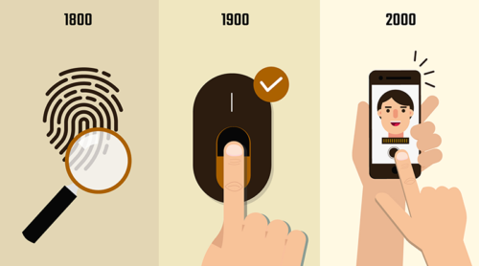

Slide 32
Why Biometrics is Required?
Protects the systems and data from unauthorized users
Biometrics is used for authenticating and authorizing a person
Authentication (Identification)
finds out answer of question, “Are you the same who you are claiming to be?”, or, “Do I know you?”
one-to-many matching and comparison of a person’s biometrics with the whole database

Slide 33
Verification
One-to-one process of matching
Live sample entered by the candidate is compared with a previously stored template in the database
Matching with more than 70% agreeable similarity, then the verification is successful.
Authorization
Process of assigning access rights to the authenticated or verified users
Finds out the answer for the question, “Are you eligible to have certain rights to access this resource?”

Slide 34
Shortcomings of Conventional Security Aids
Recognizes some code associated with the person rather than recognizing the person who actually produced it.
They can be forgotten, lost, or stolen
They are not precise

Slide 35
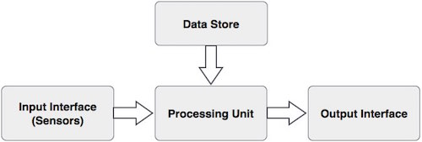
Basic Components of a Biometric System

Slide 36
Input Interface (Sensors)
Sensing component of a biometrics system that converts human biological data into digital form
A Metal Oxide Semiconductor (CMOS) imager or a Charge Coupled Device (CCD) in the case of face recognition, handprint recognition, or iris/retinal recognition systems.
An optical sensor in case of fingerprint systems.
A microphone in case of voice recognition systems.

Slide 37
Processing Unit
processing component is a microprocessor, Digital Signal Processor (DSP), or computer that processes the data captured from the sensors.
The processing of the biometric sample involves −
Sample image enhancement
Sample image normalization
Feature extraction
Comparison of the biometric sample with all stored samples in database.

Slide 38
Database Store
The database stores the enrolled sample
Recalled to perform a match at the time of authentication
Output Interface
communicates the decision of the biometric system to enable the access to the user
It could also be TCP/IP protocol, Radio Frequency Identification (RFID), Bluetooth, or one of the many cellular protocols

Slide 39
Deploying Authentication Systems
ENROLLMENT
MAINTENANCE
REVOCATION
HANDLING OPERATIONAL PROBLEMS

Slide 40
ENROLLMENT
SELF ENROLLMENT
SUPERVISED ENROLLMENT

Slide 41
MAINTENANCE
PASSWORD AGING
AUTOMATIC EXPIRATION-LONG PERIOD
TEMPLATE AVERAGING

Slide 42
REVOCATION
REMOVING PEOPLE FROM THE AUTHENTICATION SYSTEM

Slide 43
OPERATIONAL PROBLEMS
USER FORGET PASSWORDS
RESET PASSWORDS
INJURE BIOMETRIC TRAITS
LOSS OF DEVICE

Slide 44
Subverting the system
RIsks
Masquerade
Multiple identItIes
Identity theft
TRial and error attacks
Password guessing
replication
theft
digital spoofing

Slide 45
MAsquerade
By stealing the victim's account ID and password, or by using a keylogger
User's laziness and trust. Ex: if a legitimate user leaves the terminal or session open and logged in, a co-worker may act as a masquerade attacker
MULTIPLE IDENTITIES
Registering two /more times for the same benefits
IDENTITY THEFT
Obtaining key pieces of personally identifiable information (PII), such as Social Security or driver's license numbers, to impersonate someone else

Slide 46
password guessing
Dictionary attack
REPLICATION
Finding the written password and copying it for his own use
Mouse pad
Mimics -----(Disguises)---Impersonate Artifacts-----(Facsimiles)----Copy/reproduction

Slide 47
THEFT
Stealing password
can detect the theft
DIGITAL SPOOFING
Disguising fraudulent operations and making it seem genuine
Hiding the true source of packets or redirecting traffic to another location
Most common form of spoofing on a typical IP packet is modification of the source address

Slide 48
Defenses against trial and error attack
Use an advanced username and password
Limit number of login re-tries
Account lockdown after excessive login attempts
Longer passwords with varied character types
Lower FAR
Defenses against Replication attack
Liveness information-Temperature,Pulse,Movement

Slide 49
Defenses against Digital Spoofing attack
only verification
blinking or smiling

Slide 50
A real-time identification system
Identifies a person by measuring a particular physical or behavioral characteristic
Later compares it to a library of characteristics belonging to many people.
Biometric devices consist of a reader or scanning device, software that converts the scanned information into digital form, and wherever the data is to be analyzed, a database that stores the biometric data for comparison with previous records.

Slide 51
UNIT 2

Slide 52
verification mode
Verification systems are generally described as a 1-to-1 matching system because the system tries to match the biometric presented by the individual against a specific biometric already on file.
'Positive recognition' is a common use of verification mode, where the aim is to prevent multiple people from using same identity

Slide 53
Identification mode
Identification systems are described as a 1-to-n matching system, where n is the total number of biometrics in the database.
Forensic databases, where a government tries to identify a latent print or DNA discarded at a crime scene, often operate as identification systems.

Slide 54
When converting the biometric input, the software identifies specific points of data as match points. The match points are processed using an algorithm into a value that can be compared with biometric data scanned when a user tries to gain access.

Slide 55
Biometric systems can be used for either positive or negative identification.
• Recognition systems that test to see if the individual is enrolled is known as a “positive identification”
systems that verify no enrolment are called “negative identification” systems.
• Verification systems are used for positive recognition and identification systems are used in negative recognition applications.
make sure the person is not also registered as somebody else and prevents an individual from using multiple identities

Slide 56
The system, database, costs and equipment associated with negative identification systems are much higher than for positive identification.
• Negative identification systems can increase the security and safety for individuals.

Slide 57
A fingerprint is an impression left by the friction ridges of a human finger.
Forensic science
Totally unique
Not even identical twins share the same fingerprints
Ridges are completely formed by the time a fetus is 6 months old

Slide 58
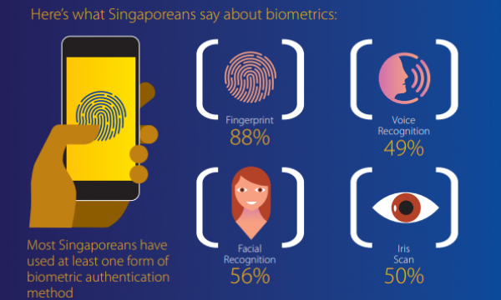

Slide 59
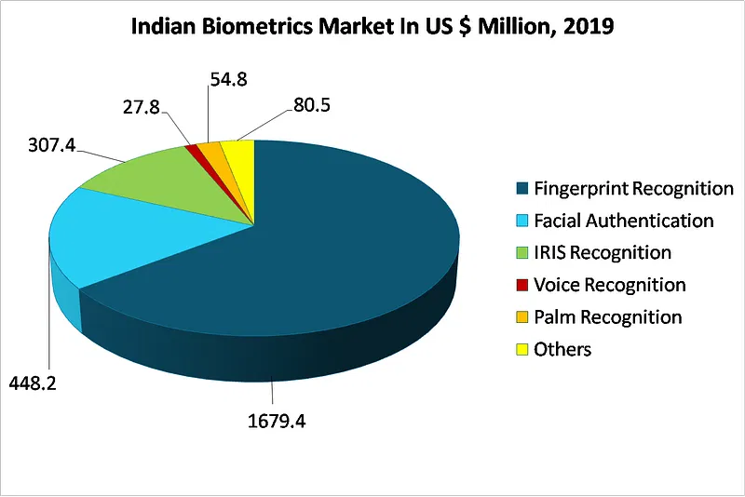

Slide 60
FIngerprint Vs other biometric elements
1-Worst 5-Best
Technology | Accuracy | Convenience | Cost | Size
Fingerprint | 5 | 5 | 4 | 4
Voice | 1 | 5 | 5 | 5
Face | 2 | 3 | 4 | 3
Hand | 3 | 3 | 2 | 2
Iris | 5 | 2 | 3 | 3

Slide 61
Security
Accuracy
–97% will return correct results
–100% deny intruders
Image
–Minutiae is retrieved and template created
•Encrypted data
–Image is discarded
•Cannot reconstruct the fingerprint from data

Slide 62
¨Several sensors to detect fake fingerprints
–Cannot steal from previous user
–Cannot use cut off finger
•Temperature
•Pulse
•Heartbeat sensors
•Blood flow

Slide 63
Each print forms a unique pattern of ridges, arches, whorls, and loops.
Ridge end and bifurcation.
The sequences of ridge end and bifurcation characteristics are different in every single fingerprint.
A ridge end consists of a ridge that ends abruptly.
Bifurcation is created by a single ridge that forks in two and continues on as separate ridges.

Slide 64
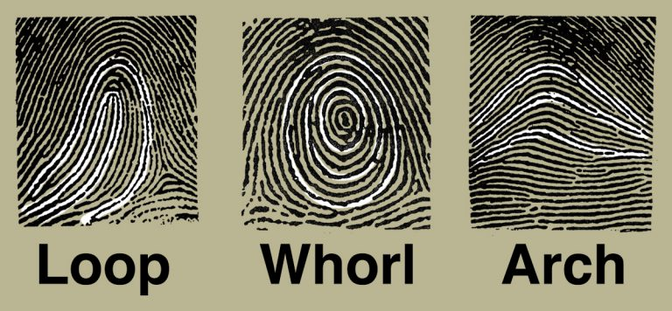

Slide 65
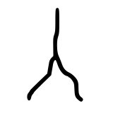
Ridge end
Bifurcation
(Short ridge) Dot

Slide 66
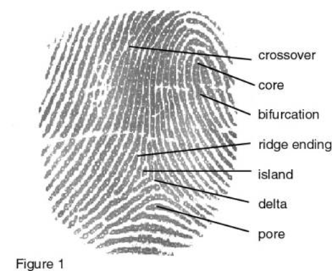
¨Minutiae
–Crossover: two ridges cross each other
–Core: center
–Bifurcation: ridge separates
–Ridge ending: end point
–Island: small ridge b/w 2 spaces
–Delta: space between ridges
–Pore: human pore

Slide 67
1858 – First systematic capture of hand images for identification purposes is recorded
Sir William Herschel, working for the Civil Service of India, recorded a handprint on the back of a contract
To distinguish employees from others who might claim to be employees when payday arrived.
First recorded systematic capture of hand and finger images that were uniformly taken for identification purposes.

Slide 68
1892 – Galton develops a classification system for fingerprints
Sir Francis Galton wrote a detailed study of fingerprints in which he presented a new classification system using prints from all ten fingers.
The characteristics (minutiae) that Galton used to identify individuals are still used today.
These details are often referred to as Galton’s details.

Slide 69
1896 – Henry develops a fingerprint classification system
Sir Edward Henry, Inspector General of the Bengal Police, consulted Sir Francis Galton regarding fingerprinting as a method of identifying criminals. Once the fingerprinting system was implemented, one of Henry’s workers, Azizul Haque, developed a method of classifying and storing the information so that searching could be performed easily and efficiently.
Sir Henry later established the first British fingerprint files in London.

Slide 70
Henry was the precursor to the classification system used for many years by the Federal Bureau of Investigation (FBI) and other criminal justice organizations that perform tenprint fingerprint searches.
In July 1901 the Fingerprint Branch at New Scotland Yard (Metropolitan Police) was created using the Henry System of Fingerprint Classification.

Slide 71
1903 – NY State Prisons begin using fingerprints
1969 – FBI pushes to make fingerprint recognition an automated process
The FBI contracted the National Institute of Standards and Technology (NIST) to study the process of automating

Slide 72
1975 – FBI funds development of sensors and minutiae extracting technology
The FBI funded the development of scanners and minutiae extracting technology, which led to the development of a prototype reader.
At this point, only the minutiae were stored because of the high cost of digital storage.
Focused in automatic methods of digitizing inked fingerprints and the effects of image compression on image quality, classification, extraction of minutiae, and matching.
Development of the M40 algorithm, the first operational matching algorithm used at the FBI.

Slide 73
1994 – Integrated Automated Fingerprint Identification System (IAFIS) competition is held
The competition identified and investigated three major challenges:
(1) digital fingerprint acquisition
(2) local ridge characteristic extraction
(3) ridge characteristic pattern matching. Lockheed Martin was selected to build the FBI’s IAFIS.

Slide 76
Manual matching of fingerprints
3 levels :
Level 1/ Galton level- Overall appearance -Pattern / ridge flow-loop/whrol/arch
Level 2 - Friction ridge detail and path-Uniquenes/ individuality
x and y locations overlaid on the fingerprint and theta 𝛳
Level 3 - ridge dimensional attributes- edge shape , width ,location of pores

Slide 77
If level1 have same data then level 2 minutiae points and relationships are examined to match the two impressions are from the same finger of same individual
Each time a fingerprint image is captured, results are different (over/undreinking/dirt/oils/moisture/orientation)
Change the x and y location of minutiae

Slide 78
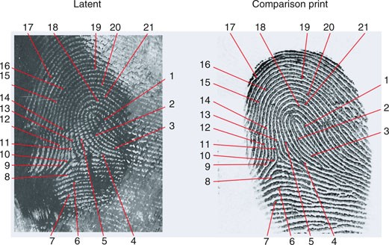

Slide 79
OPTICAL FINGERPRINT SCANNER
The technology works by capturing a two-dimensional optical image of the fingerprint and analyzing ridges and valleys.
Central to optical scanning technology is a light sensor system called a charge coupled device .

Slide 80
The CCD essentially captures an image of the finger with the help of LEDs to illuminate the surface of the finger
CCD sensors are complex electronic components that consist of multiple arrays of light sensitive semiconductor elements. Each element represents a photo detector, a pixel that converts incoming photons into electrons.

Slide 81
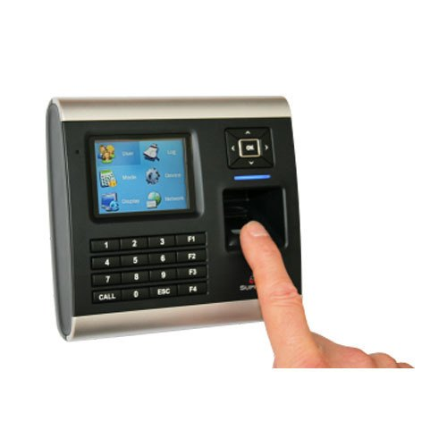

Slide 82
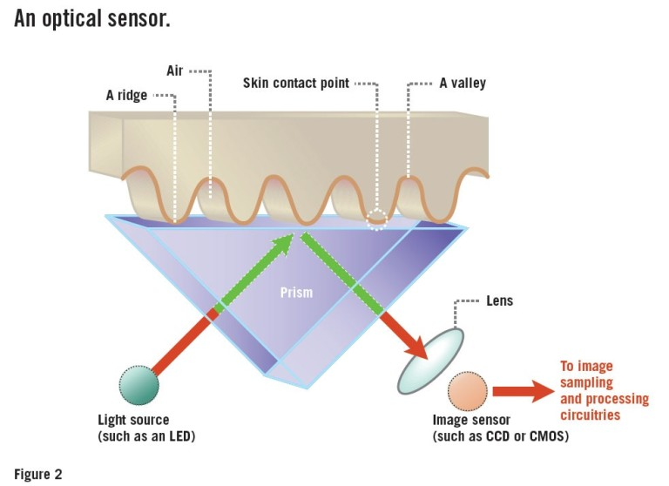

Slide 83
CAPACITIVE FINGERPRINT SCANNER
Found on phones
It measures your finger by using human conductivity, creating an electrostatic field, and creating a digital image based on the electrostatic field
uses tiny capacitor array circuits that track the detail of a fingerprint.
It uses the ridges of your fingerprint that is placed over the conductive plates which changes the charge stored in the capacitor, while the valleys (air gaps) leave the charge on the capacitor unchanged.
An operational amplifier integrator circuit tracks these changes that can then be recorded by an analog-to-digital converter, where this digital data can be analyzed.

Slide 84
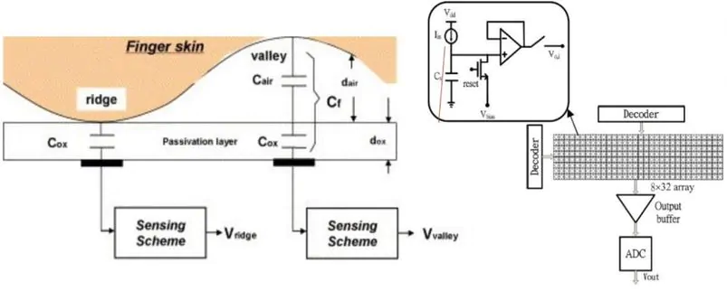

Slide 85
Ultrasonic scanners
Hardware consists of both an ultrasonic transmitter and a receiver.
An ultrasonic pulse is transmitted against the finger that is placed over the scanner.
Some of this pulse is absorbed and some of it is bounced back to the sensor, depending upon the ridges, pores and other details that are unique to each fingerprint

Slide 86
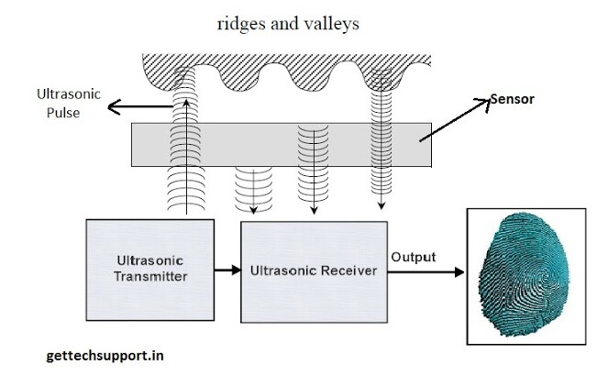

Slide 87
Hand geometry Based on the palm and fingers structure
Including width of the fingers in different places, length of the fingers, thickness of the palm area, etc.
Not very distinctive among people
Very useful for identity verification, i.e. personal authentication
In 1996 during the Olympic Games in Atlanta when it was used for access control in the Olympic village
systems handled the enrollment of over 65,000 people. Over 1 million transactions were processed in a period of 28 days

Slide 88
Time sensitive
Shape of the hand can be changed during illness, aging or weight changing.
Based on the fact that every person has differently formed hand which will not drastically change in the future.
Technologies for reading human hand can be divided in three categories:
Palm technology,
Hand vein technology,
Hand geometry and hand shape technology.

Slide 89
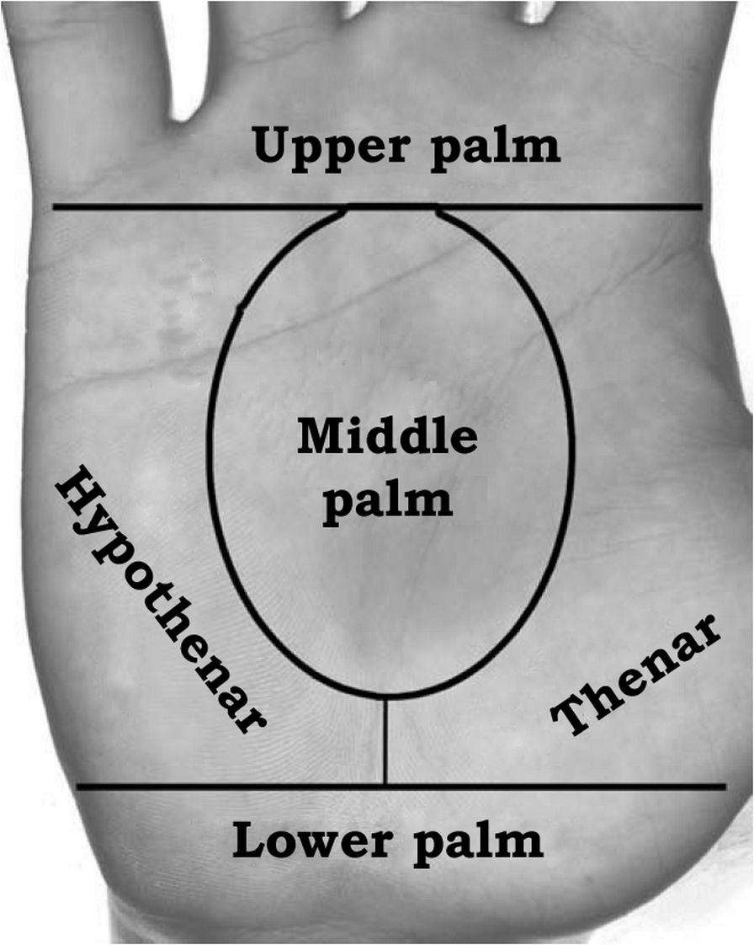

Slide 90
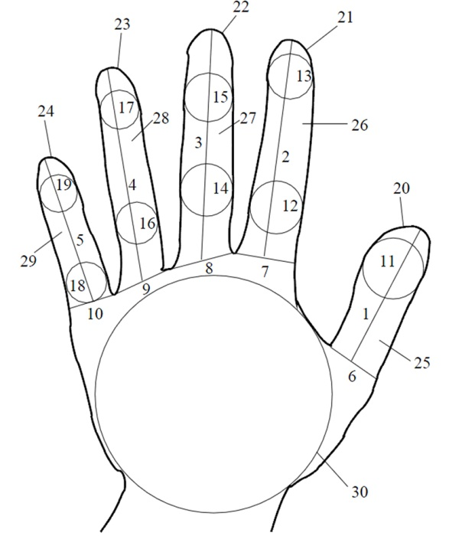

Slide 91
Thumb length
Index finger length
Middle finger length
Ring finger length
Pinkie length
Thumb width
Index finger width
Middle finger width
Ring finger width
Pinkie width
Thumb circle radius
Index circle radius lower
Index circle radius upper

Slide 92
14.Middle circle radius lower
15.Middle circle radius upper
16.Ring circle radius lower
17.Ring circle radius upper
18.Pinkie circle radius lower
19.Pinkie circle radius upper
20.Thumb perimeter
21.Index finger perimeter
22.Middle finger perimeter
23.Ring finger perimeter
24.Pinkie perimeter

Slide 93
25.Thumb area
26.Index finger area
27.Middle finger area
28.Ring finger area
29.Pinkie area
30.Largest inscribed circle radius

Slide 94
Pegs ---to place the hand in the right position.
Many hand geometry systems have pegs guided hand placement.
User has to place his/her hand according to pegs in the device surface.
The image of the hand is captured using ordinary digital camera.
Length of the fingers, their width, thickness, curvature and relative location of all mentioned features are different among all people.
Device measures a hand couple of times to get a representative sample that will be compared against all others.
Using the application defined for given purpose, the processor converts these measurements to biometric pattern.
This process is simply called sampling.

Slide 95
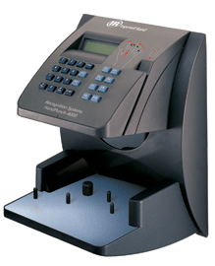

Slide 96
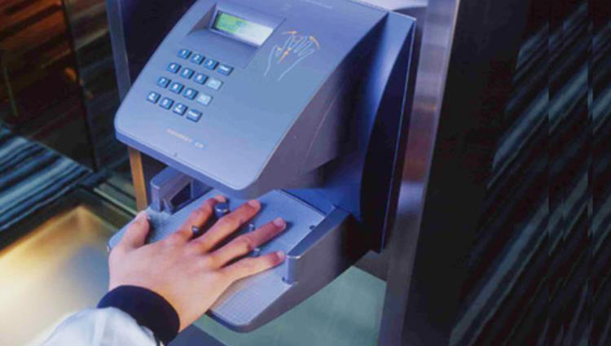

Slide 98
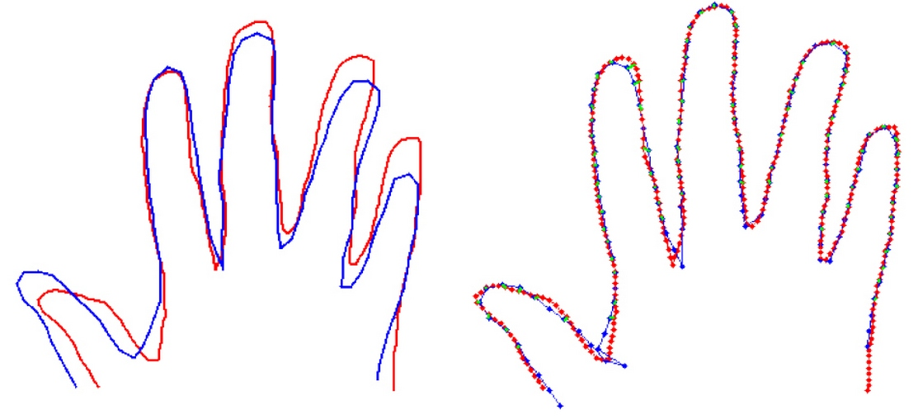

Slide 99
Aging, i.e. the changing of the hand during the time.
Hand image is time sensitive, but there is an open question if it is necessary to change the input images of the hand from time to time.
Easy to forge by finding the most appropriate hand (one has to find the hand that is “close enough”)
From a hundred randomly chosen persons, at least two will have similar hand geometry.
The hand injury can potentially have great impact on the recognition system.

Slide 100
Face recognition System
Method of identifying or verifying the identity of an individual using their face.
Can be used to identify people in photos, video, or in real-time.

Slide 101
How Face Recognition Works
Based on the ability to recognize a face and then measure the various features of the face.
Every face has numerous, distinguishable landmarks, the different peaks and valleys that make up facial features.

Slide 102
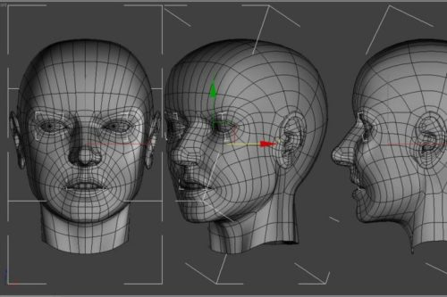

Slide 103
facial recognition software uses a 3D model,
provide more accuracy.
Capturing a real-time 3D image of a person's facial surface, 3D facial recognition uses distinctive features of the face -- where rigid tissue and bone is most apparent, such as the curves of the eye socket, nose and chin -- to identify the subject. These areas are all unique and don't change over time.

Slide 104
Using depth and an axis of measurement that is not affected by lighting, 3D facial recognition can even be used in darkness and has the ability to recognize a subject at different view angles with the potential to recognize up to 90 degrees (a face in profile).

Slide 105
steps to verify the identity of an individual
Detection
Acquiring an image can be accomplished by digitally scanning an existing photograph (2D) or by using a video image to acquire a live picture of a subject (3D).
Alignment
Once it detects a face, the system determines the head's position, size and pose. As stated earlier, the subject has the potential to be recognized up to 90 degrees, while with 2D, the head must be turned at least 35 degrees toward the camera.
Measurement
The system then measures the curves of the face on a sub-millimeter (or microwave) scale and creates a template.
Representation
The system translates the template into a unique code. This coding gives each template a set of numbers to represent the features on a subject's face.

Slide 106
Matching
If the image is 3D and the database contains 3D images, then matching will take place without any changes being made to the image.
When a 3D image is taken, different points (usually three) are identified. For example, the outside of the eye, the inside of the eye and the tip of the nose will be pulled out and measured.
Verification or Identification
In verification, an image is matched to only one image in the database (1:1). For example, an image taken of a subject may be matched to an image in the Department of Motor Vehicles database to verify the subject is who he says he is. If identification is the goal, then the image is compared to all images in the database resulting in a score for each potential match (1:N). In this instance, you may take an image and compare it to a database of mug shots to identify who the subject is.

Slide 107
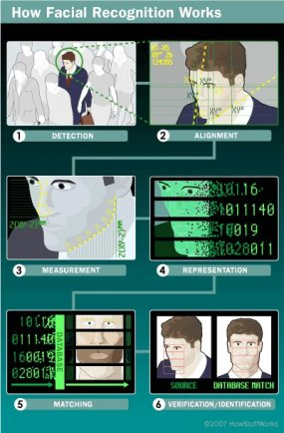

Slide 108
Surface Texture Analysis
A picture is taken of a patch of skin, called a skinprint. That patch is then broken up into smaller blocks. Using algorithms to turn the patch into a mathematical, measurable space, the system will then distinguish any lines, pores and the actual skin texture. It can identify differences between identical twins, which is not yet possible using facial recognition software alone.
· Significant glare on eyeglasses or wearing sunglasses
· Long hair obscuring the central part of the face
· Poor lighting that would cause the face to be over- or under-exposed
· Lack of resolution (image was taken too far away)

Slide 109
Facial recognition system uses
For security and to eliminate voter fraud
US-VISIT (United States Visitor and Immigrant Status Indicator Technology),
ATM and check-cashing security.

Slide 110
voice recognition system
Speaker recognition /voice authentication
Analyzes of a person’s voice to verify their identity
Airways ,soft-tissue cavities, shape and movement of the mouth and jaw, influence voice patterns to create a unique “voiceprint”
Combination of both physiological and behavioral modalities

Slide 111
Physiological Component − Physical shape, size, and health of a person’s vocal cord, and lips, teeth, tongue, and mouth cavity.
Behavioral Component − Emotional status of the person while speaking, accents, tone, pitch, pace of talking, mumbling, etc.

Slide 112
Voice Recognition System
At the time of enrollment, the user needs to speak a word or phrase into a microphone.
This is necessary to acquire speech sample of a candidate.
The electrical signal from the microphone is converted into digital signal by an Analog to Digital (ADC) converter.
It is recorded into the computer memory as a digitized sample.
The computer then compares and attempts to match the input voice of candidate with the stored digitized voice sample and identifies the candidate

Slide 113
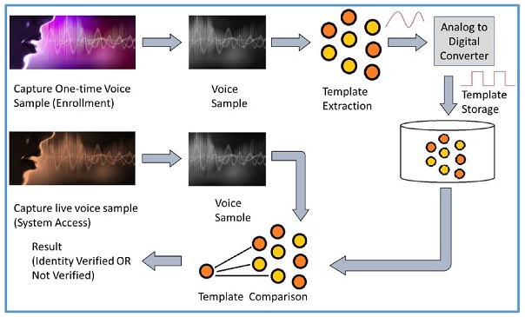

Slide 114
Speaker recognition methods
Text independent: Voice authentication is performed using any spoken passphrase or other speech content.
Text-dependent: The same passphrases are used in enrollment and for verification. This means that a speaker cannot say anything he or she would like to authenticate, but will be asked to speak a predetermined phrase. In static text-dependent voice authentication, the same passphrase is used for every verification. In dynamic text-dependent voice authentication, a randomized passphrase such as a number sequence is generated for the user. This content must also be enrolled.

Slide 115
Voice Recognition Modalities
Speaker dependent
Needs voice training (or enrollment)
Good option if there is only one user going to use the system
Speaker independent
Recognize the speech from different users by restricting the contexts of the speech such as words and phrases
Do not require training the system on each individual user

Slide 116
Voice authentication use cases
Hands-free mobile authentication.
Google Home or Amazon’s Alexa.
Virtual assistants are increasingly used to place orders and perform other functions that typically require some form of authentication.
customer-support calls. Users may find this more convenient and secure than sharing personal information such as their license or credit-card number for identity verification.
Performing telephone and internet transactions.
Working with Interactive Voice Response (IRV)-based banking and health systems.
Applying audio signatures for digital documents.
In entertainment and emergency services.

Slide 117
Advantages
Widely accessible for authentication on mobile phones given that all phones have microphones
Cost-effective to integrate into other devices such as automobiles and home appliances
It is easy to implement
Convenient and familiar for most users
Contactless, and therefore less invasive and more hygienic
Useful for phone-based use cases such as customer service

Slide 118
disadvantages
Not as accurate as other biometric modalities (e.g., facial recognition).
Requires liveness detection to verify that a sample is from a live speaker and not a recording.
Background noise can impact the the quality of the sample and, in turn, matching performance.
Not ideal for all environments (e.g., noisy or public spaces).
It is susceptible to quality of microphone and noise.
The inability to control the factors affecting the input system can significantly decrease performance.
Some speaker verification systems are also susceptible to spoofing attacks through recorded voice.

Slide 119
Difference between Voice and Speech Recognition
Speaker Recognition (Voice Recognition) | Speech Recognition
The objective of voice recognition is to recognize WHO is speaking. | The speech recognition aims at understanding and comprehending WHAT was spoken.
It is used to identify a person by analyzing its tone, voice pitch, and accent. | It is used in hand-free computing, map, or menu navigation.

Slide 120
UNIT 3

Slide 121
iris recognition
Measures the unique patterns in the colored circle of your eye to verify and authenticate your identity
Iris pattern is unique and remains unchanged
Opens and shuts the pupil of the eye like a camera shutter
Pigment called melanin—more melanin gives you browner eyes and less produces bluer eyes
Blue eyes," "green eyes," "brown eyes
Eyes are quite different from each other and even genetically identical twins have different iris patterns

Slide 122
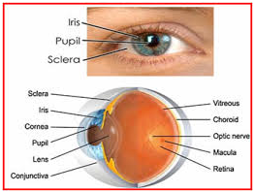

Slide 123
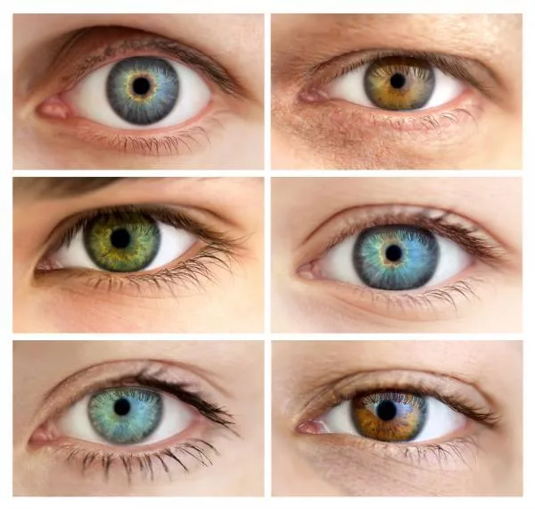

Slide 124
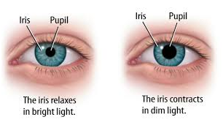
Regulates the amount of light entering the eye.
bright light, the iris closes the pupil to let in less light. low light, the iris opens up the pupil to let in more light.

Slide 125
Features of iris recognition
Highly accurate and fast, iris recognition boasts of having top-class precision among different types of biometric authentication technologies.
Remains unchanged throughout life.
Since the iris is different between the left and right eye, recognition can be performed separately by each eye.
Possible to distinguish twins.
As long as the eyes are exposed, iris recognition can be used even when the subject is wearing a hat, mask, eyeglasses or gloves.
Because of using an infrared camera, recognition is available even at night or in the dark.
Without the need to touch the device, contactless authentication is possible, making it hygienic to use.

Slide 126
Mechanism of iris recognition
First, the location of the pupil is detected, followed by detection of the iris and the eyelids.
Unnecessary parts (noise), such as eyelids and eyelashes, are excluded to clip out only the iris part, which is then divided into blocks and converted into feature values to quantify the image.
Matching is then performed with feature data previously extracted in the same methods.

Slide 128
immigration control

Slide 129
national id card
Driver’s licenses, and voter ID systems

Slide 130
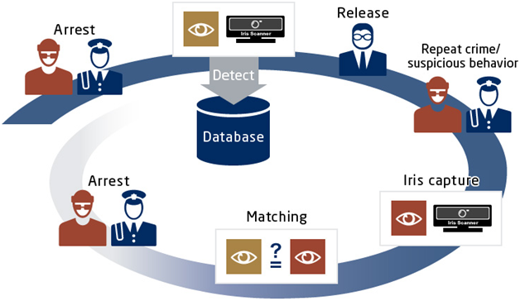
crime investigation

Slide 131
retina scanning
“Ultimate Biometric of All”.
Thin tissue composed of neuralcells that is located in the posterior portion of the eye
Complex structure of the capillaries that supply the retina with blood, each person’s retina is unique
Even identical twins do not share a similar pattern
Retinal patterns may be altered in cases of diabetes, glaucoma or retinal degenerative disorders, the retina typically remains unchanged from birth until death
Biometric identifier known as a retinal scan is used to map the unique patterns of a person’s retina

Slide 132
The blood vessels within the retina absorb light more readily than the surrounding tissue and are easily identified with appropriate lighting
Retinal scan is performed by casting an unperceived beam of low-energy infrared light into a person’s eye as they look through the scanner’s eyepiece
This beam of light traces a standardized path on the retina. Because retinal blood vessels are more absorbent of this light than the rest of the eye, the amount of reflection varies during the scan.
The pattern of variations is converted to computer code and stored in a database
Retinal scanning also has medical applications

Slide 133
Retinal Scanning requires a very close encounter with a scanning device that sends a beam of light deep inside the eye to capture an image of the Retina
Examining the eyes using retinal scanning can aid in diagnosing chronic health conditions such as congestive heart failure and atherosclerosis
Diseases such as AIDS, malaria, chicken pox and Lyme disease, as well as hereditary diseases, such as leukemia, lymphoma, and sickle cell anemia, also impact the eyes and can be detected using retinal scan technology

Slide 134
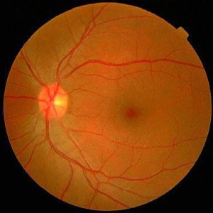

Slide 135
Retinal scan algorithms require a high-quality image and will not let a user enroll or verify until the system is able to capture an image of sufficient quality.
The retina template generated is typically one of the smallest of any biometric technology.
Retinas scans are about 70 times more accurate than iris scans and 20,000 times more accurate than fingerprint-based methods.
However, a retina scan does require the subject to focus on a single point for the entire 15-second duration.

Slide 136
Retina scans are nearly impossible to fake.
Retina decays so quickly after death, a scan can only be accessed from a living human.
400 unique data points can be captured from the Retina
The size of the Retinal Enrollment Template is only at 96 bytes.

Slide 137
MERITS OF RETINAL SECURITY SCAN SYSTEM
Retinal scanners do not require as much computer memory as other biometrics scans.
It delivers accuracy and offers very low false acceptance and rejection rate. Unlike voice recognition systems, these scanners do not get distracted by the noises in the background or change in the frequency of voice caused by illness.
It is highly scalable for any size of a project. The retinal security scanning technology has been deployed in many government projects like national ID or immigration as well as in healthcare sectors.

Slide 138
An individual’s retina can be scanned from a close distance which ensures hygiene factor, unlike fingerprint scanning where you have to place your fingers on the device.
The retinal security scanning is extremely difficult to be forged because of the uniqueness of the patterns. As a result, even with its disease related drawbacks, it still assures the highest level of security and become the most reliable biometric authentication system.

Slide 139
esoteric biometrics
These are techniques which are in early developmental stages.
Tommorow’s Commercial - Off - The- Self technologies COTS products

Slide 140
UNIT 4

Slide 141
Vein pattern
Facial Thermography
DNA
Sweat pores
Hand Grip
Fingernail bed
Body odor
Ear
Gait
Brain vein pattern
Skin Luminance
Footprint and foot dynamics

Slide 142
Vein pattern
Vascular pattern recognition, also commonly referred to as vein pattern authentication, uses near-infrared light to reflect or transmit images of blood vessels
The vascular pattern of the human body is unique to a specific individual and does not change as people age.
Near-infrared rays generated from a bank of light emitting diodes (LEDs) penetrate the skin of the back of the hand. Due to the difference in absorbance of blood vessels and other tissues, the reflected near-infrared rays produce an image processing techniques producing an extracted vascular pattern. From the extracted vascular pattern, various feature rich data such as vessel branching points, vessel thickness and branching angels are extracted and stored as a template.
Vascular patterns are difficult to recreate because they are inside the hand and, for some approaches, blood needs to flow to register an image.

Slide 143
FAcial thermography
Facial thermography works by detecting heat patterns created by the branching of blood vessels that are emitted from the skin.
These patterns, known as thermograms, are highly unique. As a consequence, identical twins have different thermograms.
Thermograms, generally, are visual displays of the amount of infrared energy emitted, transmitted, and reflected by an object, which are then converted into a temperature, and displayed as an image of temperature distribution.
Thermography works very much like facial recognition, except that an infrared camera is used to capture the images.
Thermograms as a mechanism of biometric identification are advantageous since the technology is non-intrusive.

Slide 144
dna
deoxyribonucleic acid (DNA) provides the most reliable personal identification. It is intrinsically digital, and does not change during a person’s life or after his/her death.
DNA, which can be thought of as the blueprint for the design of the human body, is folded inside the nucleus of each cell. DNA is a polymer, and is composed of nucleotide units that each has three parts: a base, a sugar, and a phosphate. The bases are adenine, guanine, cytosine and thymine, abbreviated A, G, C and T, respectively. These four letters represent the informational content in each nucleotide unit
Meanwhile, the phosphate and sugar portions form the backbone structure of the DNA molecule.
DNA can be easily obtained from a variety of biological sources, not only body fluid but also nail, hair.

Slide 145
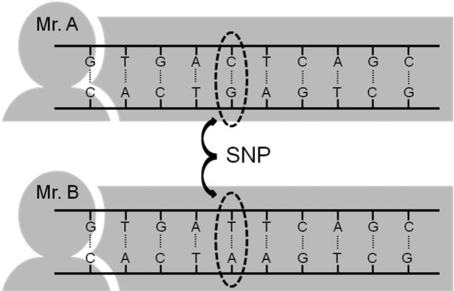
Single nucleotide polymorphism

Slide 146
sweat pores recognition
To improve precision, the new technology adds recognition of sweat pores to the identification process. Sweat pores, like the fingerprint itself, differ from person to person. The new process measures pore positions relative to each other and to the lines in a fingerprint.

Slide 147
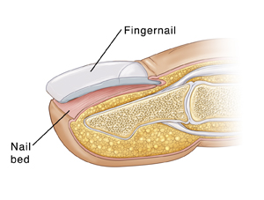
Fingernail Bed Recognition
Fingernail bed recognition is being researched in order to find a system that can scan the arteries and veins in the fingernail.
The vascular rich dermal layer at the base of the fingernail has unique structures that can differentiate between individuals.
Even identical twins have different fingernail beds.

Slide 148
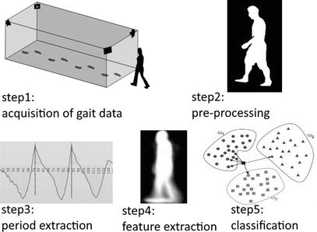
Gait recognition has received increasing attention as a remote biometric identification technology
is hard to imitate

Slide 149
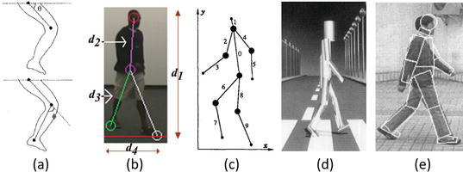

Slide 150
Brainwaves have remarkable properties that can be used against spoofing attacks (Fraschini et al., 2015). Brain activity-based biometrics are far more secure than the existing fingerprint or facial identification technologies, since it cannot be exposed or used without the user’s knowledge.
It is also less likely to be artificially produced
An electroencephalogram (EEG) is a test used to evaluate the electrical activity in the brain. Brain cells communicate with each other through electrical impulses. An EEG can be used to help detect potential problems associated with this activity.
An EEG tracks and records brain wave patterns.
In the enrollment process brain activities are recorded in order then to be further examined for unique features used for authentication. The second part is an authentication process that compares the features of newly acquired brain activities with the already recorded features of those activities.

